Slide 1
Unit 1 Lesson 7
Practice Problems

Slide 3
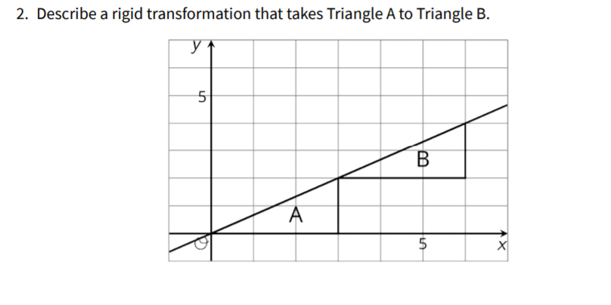

Slide 4
